Slide 1
Staying safe in a digital world!
If you have any questions that you might not want to ask out loud, please write on a post-it note and stick to the board at the front.
Many thanks ☺

Slide 2

You wouldn’t let your child go swimming without lessons!

Slide 3
What we will do tonight:
Online Safety Quiz.
Update on E-Safety – children will go out with Miss Owen.
Make a family agreement!

Slide 4
Quiz
Please write on the answer sheet what you know about your children’s online behaviour.
Children can write their own answers but keep them secret from your parents until the end of the quiz.

Slide 5
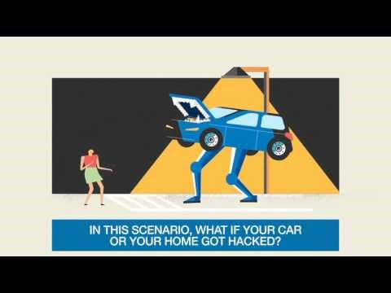
Internet of Things - Data

Slide 6
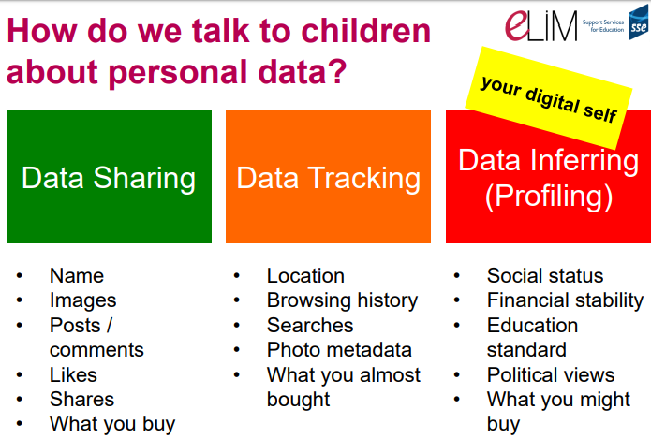

Slide 7
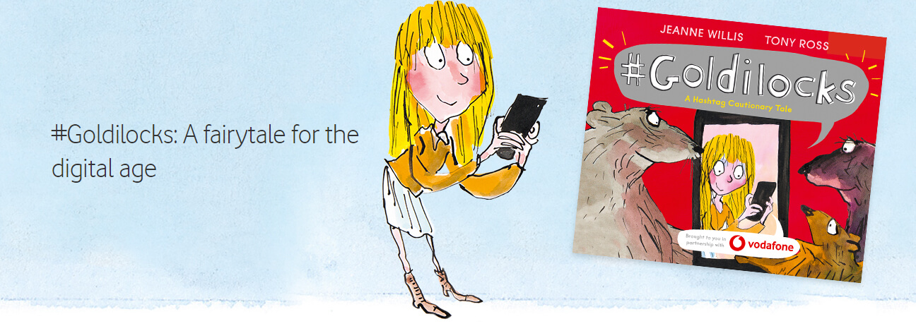
Children to go with Miss Owen.
https://www.vodafone.co.uk/mobile/digital-parenting/goldilocks

Slide 8

Video Clip – Be a Tech Role Model
https://youtu.be/NPlDsznUiY0

Slide 9
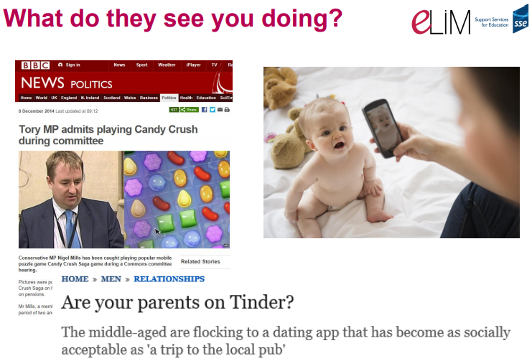

Slide 10
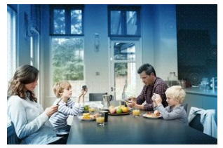

#1: Parents on phone have children who are more negative and less resilient.
#2. Children feel unimportant, and have to compete with smartphones for parents’ attention.
#3. Distracted parental attention harms children’s social/emotional development.
#4. Mobilephone use interferes with healthy parenting
#5. Kids feel sad, mad, angry, and lonely when parents use mobilephones.

Slide 11
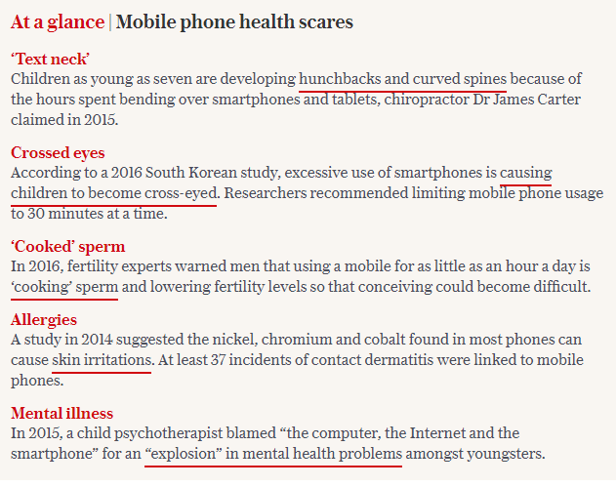
Parents' excessive use of mobile phones is driving behavioural problems among children, study finds
https://www.telegraph.co.uk/news/2018/07/05/duty-care-mothers-excessive-use-mobile-phones-driving-behavioural/

Slide 12
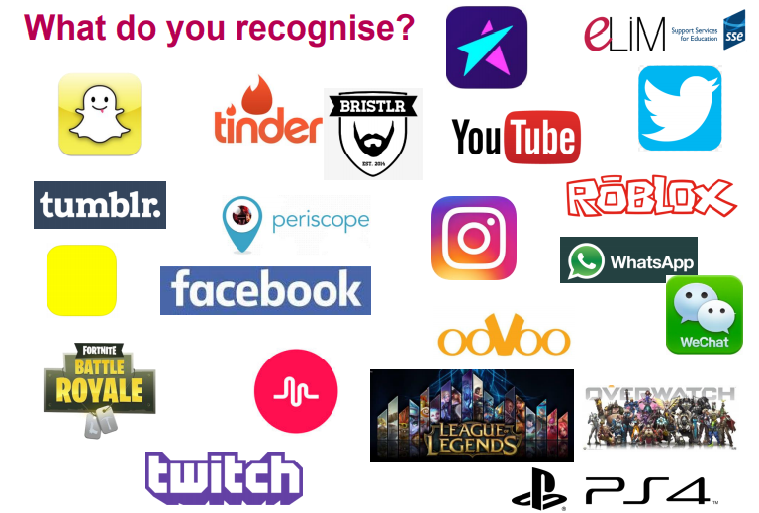
Explore together

Slide 13
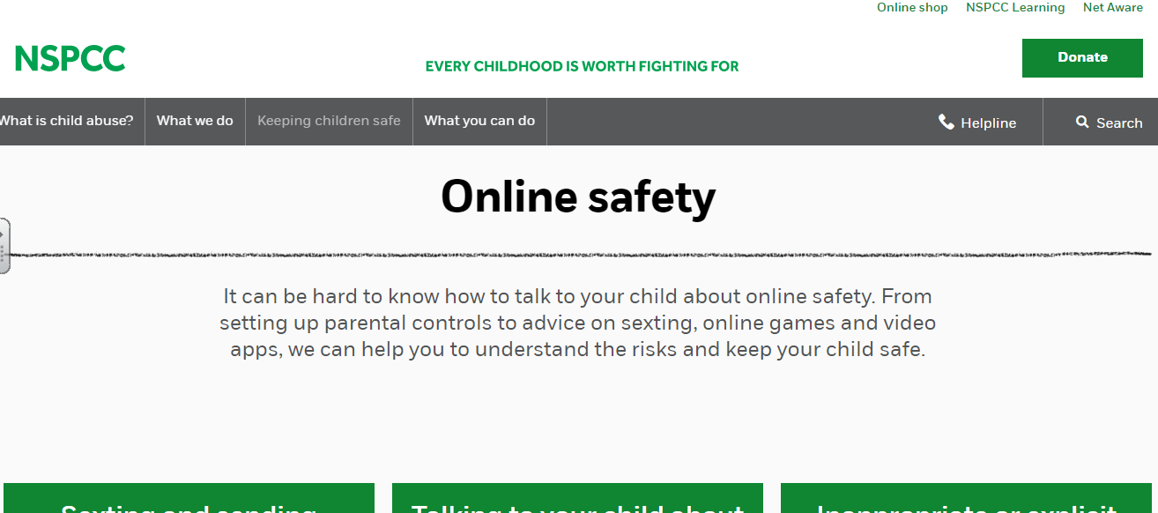
Cyber Bullying and XXX – Links to other concerns can be found on this website.
https://www.nspcc.org.uk/keeping-children-safe/online-safety/

Slide 14
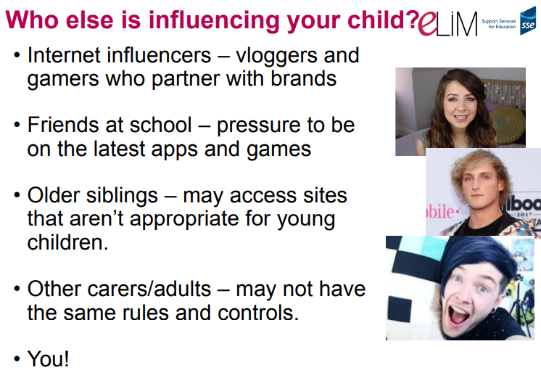

Slide 15
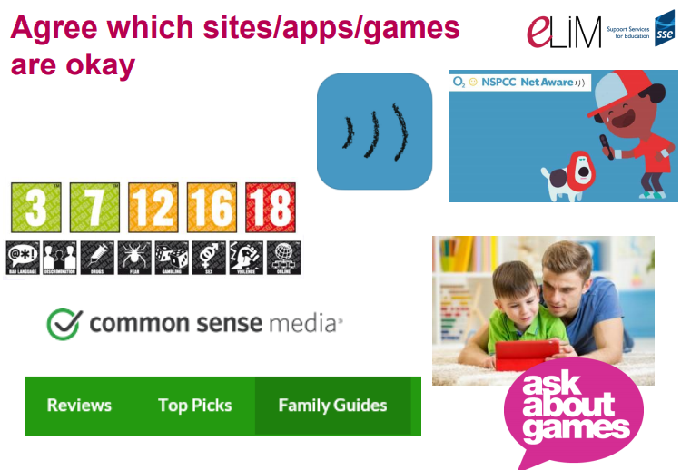

Slide 16

https://www.vodafone.co.uk/mobile/digital-parenting/tips-on-digital-life-balance

Slide 17
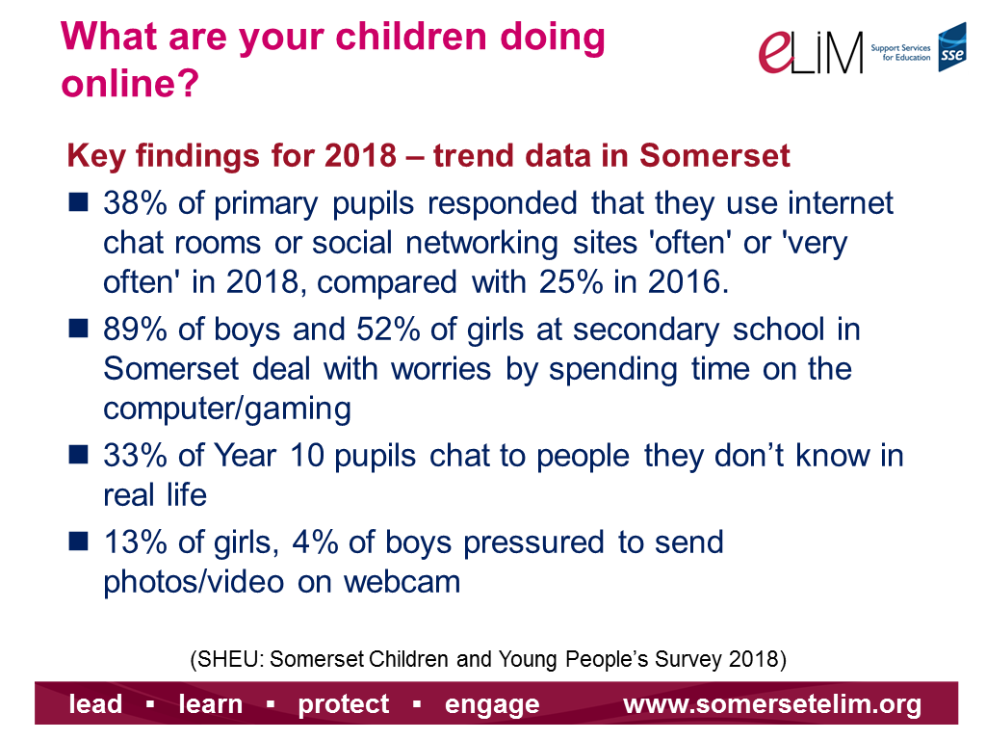

Slide 18
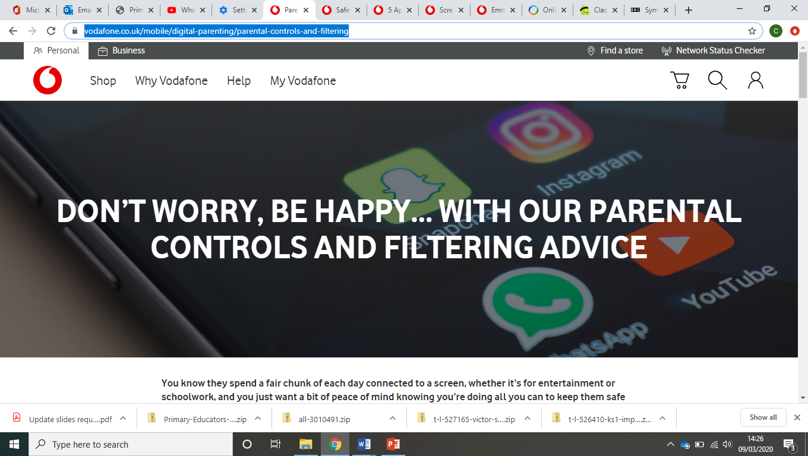
https://www.vodafone.co.uk/mobile/digital-parenting/parental-controls-and-filtering

Slide 19
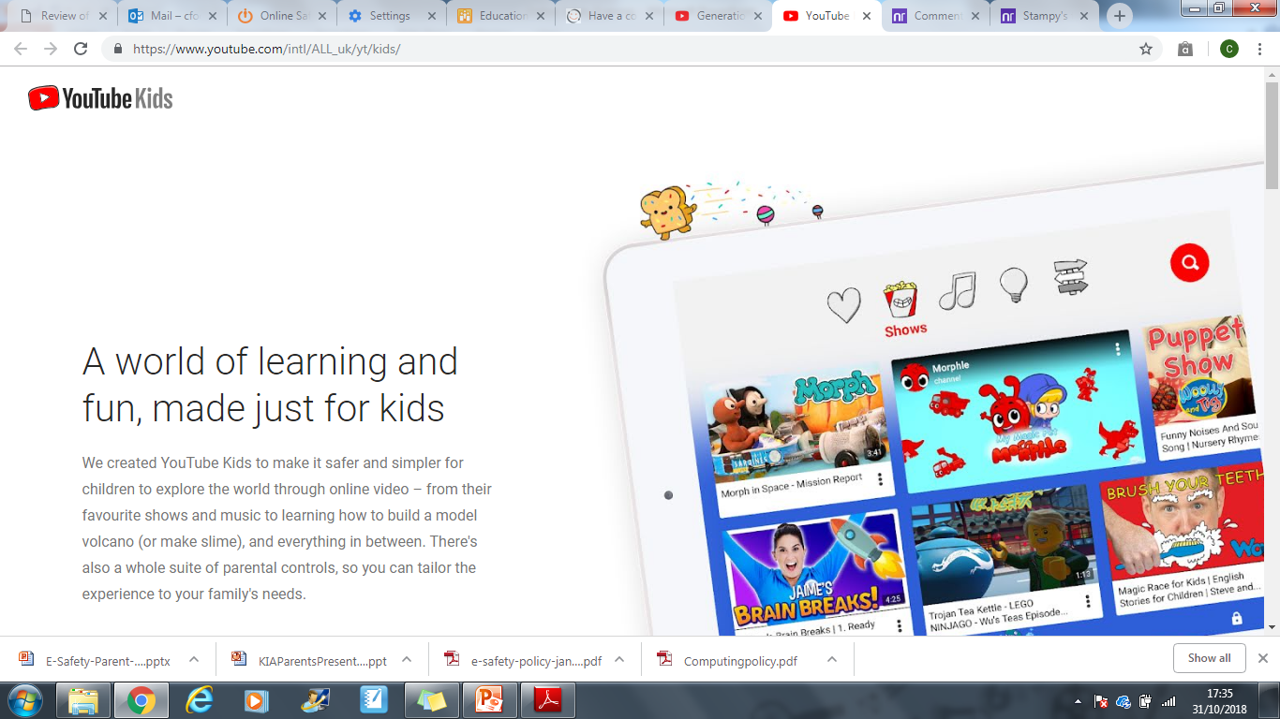
YouTube Kids
Great for videos but very easy to come across content not suitable for children.
Parental controls and settings
You can access parental controls and other settings at any time by following these steps:
Tap the Lock icon in the bottom corner of any page in the app.
Complete the multiplication problem or read and enter the numbers that appear. Or, enter your custom passcode.
Select Settings .
Your child can also control some settings.

Slide 20
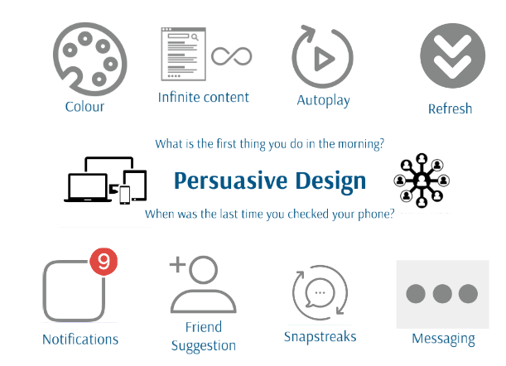
Addictive

Slide 21
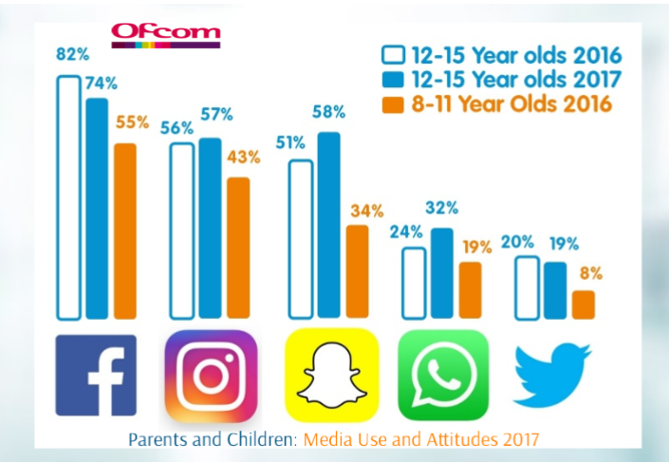
Snapchat, Instagram, Facebook and Twitter

Slide 22
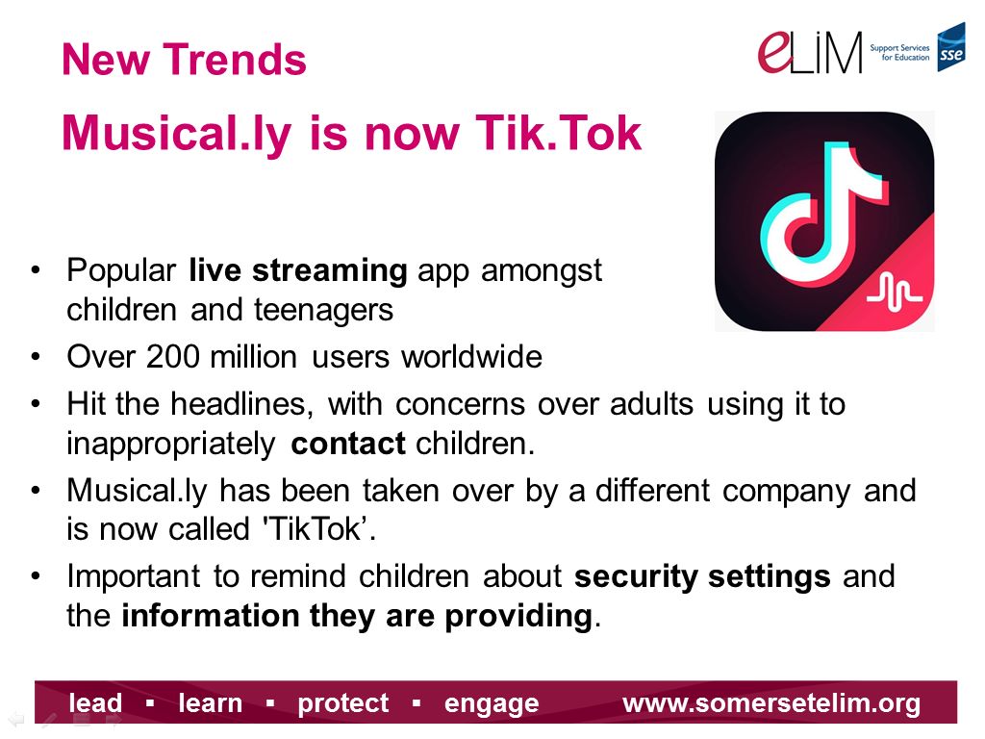

Slide 23


Fortnite and Roblox
Fortnite: Battle Royale is a game which combines Minecraft-style building with shooting for survival. It has been described as ‘Call of Duty for kids’ and has 40 million players worldwide. It can be played on the PC, Xbox or Playstation.
Roblox is a social gaming website. It was launched in 2006 and now has over 30 million active users. It is aimed at 8-18 year olds, but players of all ages can use the site and play games together.

Slide 24
Things you can do to protect your children online
Set up parental controls and filtering on all devices! (Children are amazing at finding ways around them).
No screen time an hour before bed.
Share, play and talk together about what they are doing.

Slide 25
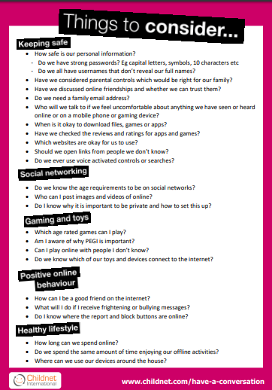
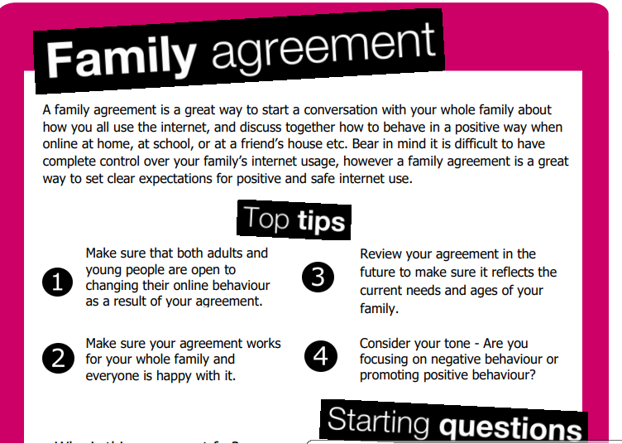
The family technology charter.

Slide 26
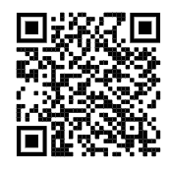
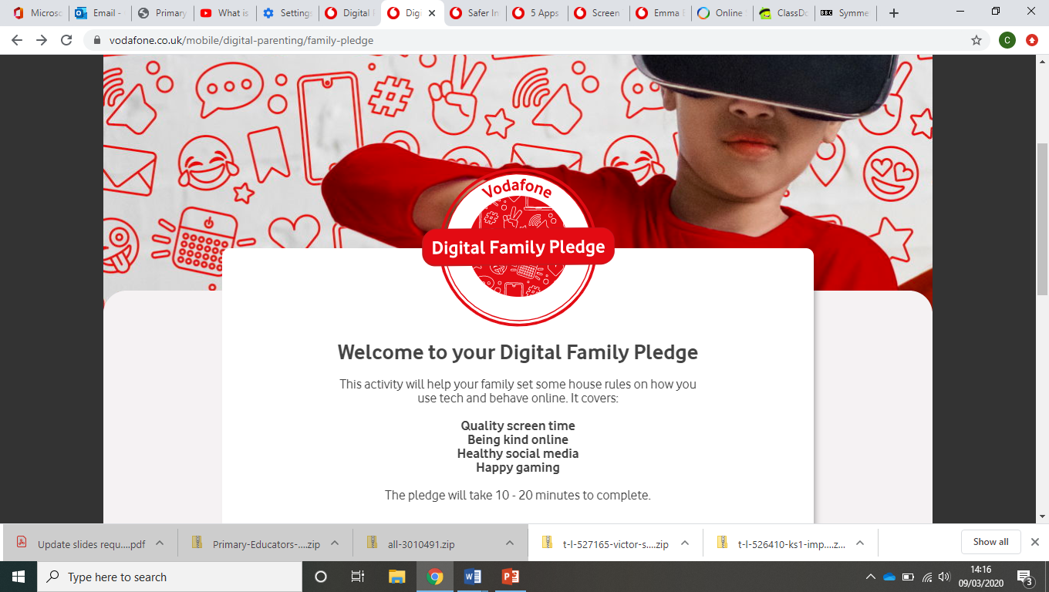
Digital Family Pledge

Slide 27

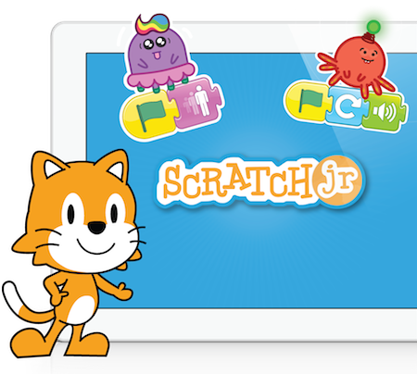

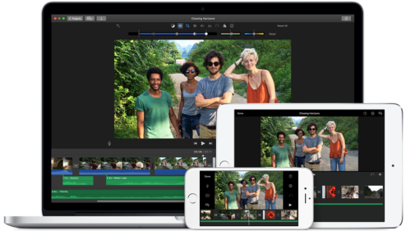
Apps
QR codes - https://www.qr-code-generator.com/a1/
Doodle Buddy
I can animate
Scratch junior
iMovie
Kodable
Garage Band
Mental Maths apps
Lego fix the factory
Purple mash

Slide 28
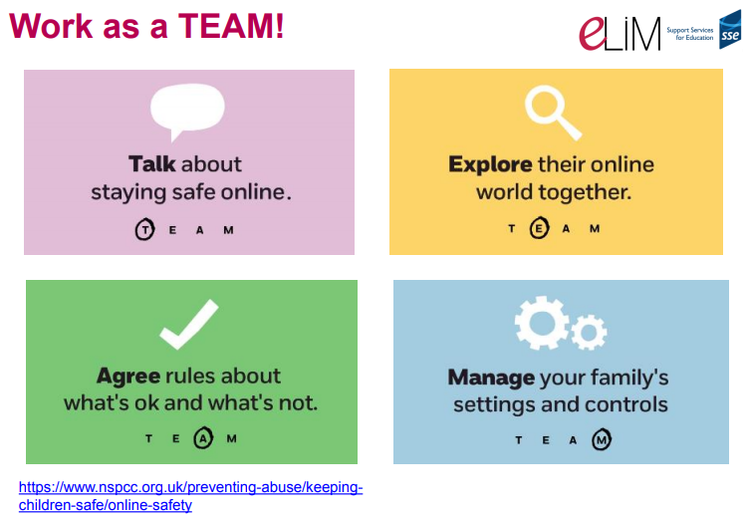

Slide 29
Digital Parenting Magazine and the online Community.
Nikki Lilly
Jaden Ashman
Alec Steel
Bella Lack
Amika George

Slide 30
Any questions?
We need some volunteers for our Parent Partnership Group.
Termly E-Safety Meeting to share ideas and concerns about E-Safety within the school and community.
Please contact Miss Foote or Miss Owen if you are interested in taking part.

